Slide 1
Data Migration QA BI SQuAD Solutions

Slide 2















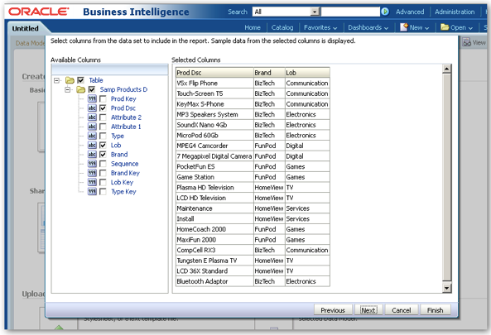




Test Coverage
Test Strategy:
For the data migrated from the source database/system to the Target database/system, Test Coverage involves ensuring the data correctness and the data completeness of the migrated data in the Target database/system against the source database/system. This involves the primary validations that follow -
Data Ingestion Checks to confirm the migration of data from source to target is successful and correct
Metadata validations between source and target database/system
Data comparison between source and target database/system
Source Database
Target
Database
On Premise/Cloud
On Cloud
Landing
Staging
Mainframe
Full / Incremental tables
Full / Incremental tables
Mainframe
Other database
LAYER 1
Compare
LAYER 1
Other database
Core
Foundation
Compare
History/Full / Incremental tables
History/Full / Incremental tables
Web Application
Web Application
LAYER 2
LAYER 2
File systems
Compare
File systems
QA Strategy
Metadata Validation
History/Full/Incremental data Validation
Report Validation
ETL and BI Performance Testing
Automation Components
Metadata Reconciler
DataLake Processing QA
Report Comparator

Slide 3









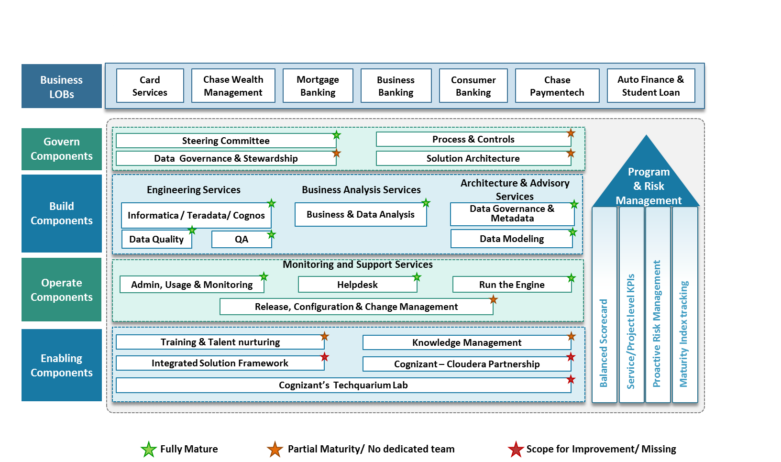















Cloud Migration QA Approach- AWS
ADF
SOURCE-
On Prem
Cloud - Centralized Data VPC
Data Comparator
Data Processing
Target-Cloud
2
3
4
5
ETL
1
S
OURC
E
Amazon EC2
Clean Area
Enriched
Load Ready
Existing Flow
Data Ingestion
Data Transformation HDFS
S3
Data comparator
JUPITER
Compute
5
Big Data
CDH Cluster
EC2 Compute
Data Files
Incremental Flow/On-going
EMR
S3
BRAVO
Streams
BRAVO : Big data Framework for Validation & Optimization
Tools &
Accelerators
Source Data Analyzer
Data Ingestion QA
Data Lake Processing QA
Analytics QA
Text Mining QA
3
Source ETL/Open Source Converter Data Processing Layer Target Data Comparator Tool
1
2
4
5

Slide 4
Cloud Migration Test Coverage
S.No | Validation Type | Description | For More details
1 | Batch Run Validation | Validation of end to end workflow to ensure migration of data from source to target is successful with all dependencies mapped.
2 | Metadata Validation | The table structure defined in the target database/system is as per the source tables/system and is as per the requirement mapping document | Click here
3 | Automated Test Design | Creation of test cases and test scripts as per the test requirement based on volume and partition key for each of the tables considered under migration in an automated manner | Click here
4 | Data Validation | Comparison of the complete history data for its count and data between the source tables/system and the target tables/system Comparison of the delta data for its count and data loaded in both the source tables/system and the target tables/system including the Incremental logic validation like Inserts, Updates, Deletes, etc. | Click here
5 | Report Validation | Comparison of the reports generated out of the source database/system against the Target database/system for the same set of data volume | Click here
6 | Performance Testing Approach | Validation of the performance of ETL jobs / Reports rendering against the Baseline provided by the Business | Click here

Slide 5
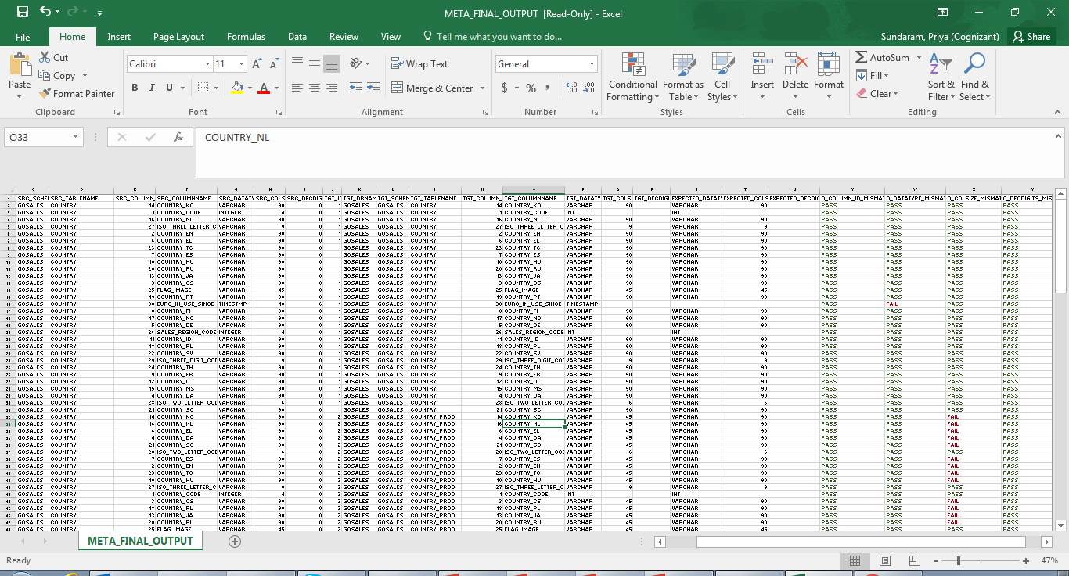
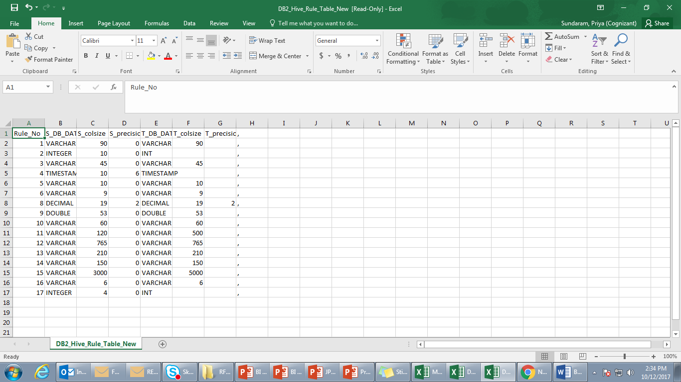
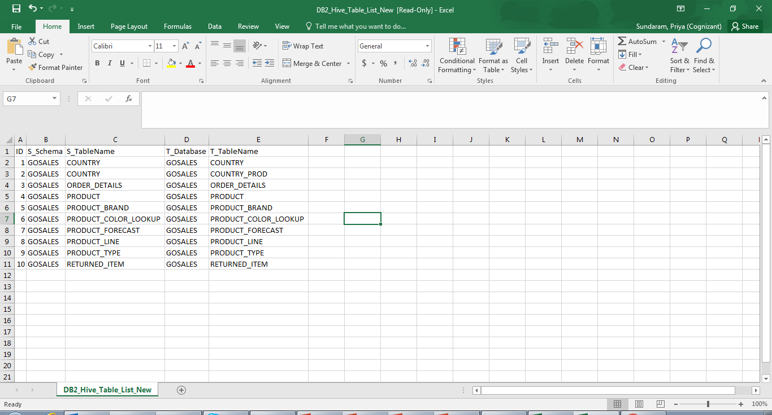
Testing Approach – Metadata Validation
Tables / Views that are considered as part of migration are compared in an automated manner for their structure between the source database/system and the Target database/system. The comparison results are obtained which can be further analyzed on the mismatches with ease.
Source Database
On Premise/Cloud
BRAVO (Metadata Reconciler)
Tables/
Views
Source Metadata Details
01
Database/ Connection Details
SOURCE
02
04
Comparison Output
Schema Information
Metadata Reconciler
Metadata Rule
Definitions
Target Database
On Cloud
Target Metadata Details
03
Metadata Validation Output
Tables/
Views
Table / View
Names
Excel Import Feature
TARGET
Back to Coverage Types

Slide 6







Testing Approach – Automated Test Design
SQL queries are automatically created for each of the Source and Target Tables / Views considered as part of migration based on the Segmentation Column. The segmentation size determines the number of segments in the table. For eg. a table with size 1000000 records and segmentation size is 100000 then there will be 10 SQL queries created for that table in both Source and Target with ease and with no manual intervention
1. Access the Source and Target environment to understand the Cluster capacity (no of Cores,RAM size etc)
BRAVO - Data Lake Processing QA
Due Diligence
2. Derive the segmentation size of each partition based on the Table / View volume statistics
Segmentation
Segmentation Size
Derive segmentation Logic
Test Engineer
Segmentation Column
Query Generation
Identify the segmentation column by data profiling
Data Segmentation Queries
Data Profiling
Back to Coverage Types

Slide 7



Testing Approach – History/Incremental Data Validation
Testing Strategy for Current Data
Existing System (Existing Db)
Testing for Current Ongoing data is accomplished by loading the data for a particular period in both existing system and new system. The datasets between the Existing database is compared with the current dataset using accelerators like BRAVO and Jupiter Tool.
Below are the list of Validations which will be carried between the Existing/ New systems
Validate the Existing data(Existing Db) with New data(Migrated Db) for data completeness
Metadata validation: Validate the DDL with the Source Mapping document
Data Quality Check: Validation of Count and data between the table and control file
Error Warning Check: Validate Threshold Limit check for errors and Data type mismatch/Not null check for errors and Warnings
Audit Validation Validate the Audit tables
Referential Integrity (RI) Validation: Validate referential integrity among the dimension/fact tables.
Data comparator is used to compare Metadata, Summary level data and Record level data.
TASQ is used to create & execute SQL scripts to compare the data and prove the mapping requirements.
Data Comparison
Extract Data
Using SQL scripts
New System(Teradata Db)
Extract History Data for a duration
Testing Strategy for History Data
New System(Migrated Db)
Test Historical data loaded in chunks in New system(Migrated Db) with the existing system (existing Db)ensures that the functionality does not break due to addition of data
Assumptions :
Existing database is up to compare the data between the new and the old system data.
New chunk of data is not loaded in the new system until the first set of data is tested thoroughly
Using BRAVO/Jupiter scripts , dataset for a particular duration is tested between New system (Migrated Db) and Existing system(existing Db)
Data Comparison
Ab Initio ETL tool
Once testing is complete for the first chunk of data. Second chunk of Historical data is loaded using Jupiter tool to New System.
Further regression testing is carried out between the New system (Migrated Db) and Existing system(existing Db) for the first and second chunk of data
Old System(existing Db)
Business Layer /Report Validation
Report Format Validation: On-Line Report Header/Footer /Contents Validation, Standard validation, Group and Conditional formatting
Functional Report Data Comparison and Validation: Data validation includes validation of reports between the old reports pointing to Existing Db with new reports pointing to Teradata database

Slide 8




Testing Approach – Report Validations
BI Reports
Testing Approach
SIT Approach will be to compare the reports generated from reports pointing to source database against the reports pointing to the Target database
Run Reports and Export to Excel
Setup required
data in EDW
2
1
Run BI Reports
Export Data to Excel
Perform Report Comparison
Comparison of Data with output from Source Database Reports with Target database reports
Source Database
3
BI
Report Output
4
Data Validation – Report Validation
Report Comparator will be used for data comparison by extracting the reports in Excel format.
Excel files will be compared as part of Data Comparison for the given input value to verify:
Data between Source database generated reports and Target database generated reports
Report
Comparator
5
Setup required
data in EDW
Run BI Reports
1
2
Export Data to Excel
Observe result set and flag issues for any Data mismatch
Target Database
3
7
BI Report Output
Back to Coverage Types

Slide 9








Performance Testing Approach
History Migration
Incremental Migration
Reports Performance Post Migration
SIT Completion
Capture the migration cut over schedule window
Monitor the history load execution runtime and schedule in Target environment
Identify the select set of jobs for performance testing on Incremental Loads
Establish baseline for Source system based on the run/requirement document
Capture runtime statistics for Target system
Identify the select set of reports for performance testing
Baseline the run time statistic for BI reports pointing from Source
Run and measure the report runtime statistics in Target environment
Compare the run times of the reports and report anomalies in case of deviations greater than threshold
Report performance issue in case the migration cut over exceeds the scheduled down time.
Compare the run times of data load jobs in Source and Target environments and report deviations greater than threshold
Flag in case of any variations from threshold
Key Considerations
8
Automated Reconciliation Scripts to reconcile data between Teradata & SAP HANA/Hadoop
Cognizant Test Team provides detailed Test Plan and coordinates Regression/UAT Testing with SCE users
Environment comparable to production Volume
Baselined Runtimes and Threshold
Seamless and adequate data provisioning
Environment Stability and availability during critical times
Back to Coverage Types

Slide 10
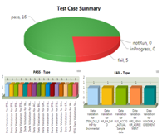
Testing Approach – End to End Validation – Future Roadmap
Below is the proposed testing approach using BRAVO tool that could validate the data end to end in an automated manner. This future road map covers the following –
Metadata validation
Test Case/Script Creation
Test Execution
Test Summary Report Creation
Source Target Mapping sheet
Source Database
On Premise/Cloud
Comparison Results
Metadata Results
Data Validation Results
BRAVO Engine
Tables/
Views
Metadata Validation
Source/Target Table Metadata Extraction
Test Script Creation
Source SQL Creation
Target SQL Creation
Metadata Comparison
Data Validation
Compare Source and Target Data
Metadata Results
Count Check
Duplicate Records Check
Missing Record Check
Mismatch Records
SOURCE
BRAVO Output
02
Target Database
On Cloud
9
Tables/
Views
TARGET

Slide 11
Thank You

Slide 12
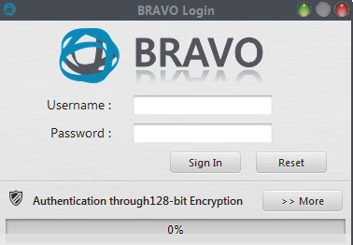

BRAVO Prerequisite
To get the BRAVO started and ready for usage in QA Environment, prerequisites / Base Configuration mentioned below should be made available in the required client systems/ VDI / any desktop.
Time taken for Bravo team to be ready for QA team usage in One system is as below -
BRAVO Installation & Configuration – 3 hours
Dry Run – 1 to 2 hours
Base Configuration Prerequisites
Windows or Citrix
CentOS, Ubuntu, RHEL
Edge Node
BRAVO Client
(Swing Based Java UI)
BRAVO libraries on EdgeNode
(Java jars, Shell scripts)
MINIMUM HARDWARE
4 GB RAM (Recommended: 8 GB RAM or greater)
Minimum 500 MB Free hard drive space (minimum)
SSH (port 22)
MINIMUM HARDWARE
Minimum 500 MB (for BRAVO installable only) Free hard drive space (minimum) on Edge note where BRAVO is installed
SOFTWARE
Java JRE/JDK 1.8x (32/64-bit)
SOFTWARE
Java JRE/JDK 1.8x (32/64-bit)
Note: JDK must of same 32 bit or 64 bit
11
-744 directory permissions required on Edge Node folder
-HDFS file Create/ Delete permission for the user

